Slide 1

UNIVERSITI PUTRA MALAYSIA
Prepared by
Information Management Division, PSAS
2014

Slide 2
How Turnitin works (Student)

Slide 3
Turnitin….
Turnitin is a suite of educational tools for digital assessment and plagiarism prevention.
To Deter Plagiarism
To Hold Students
Accountable
To Determine The
Similarity Of Text
To Sources
To Enhance Teaching &
Student Learning

Slide 4
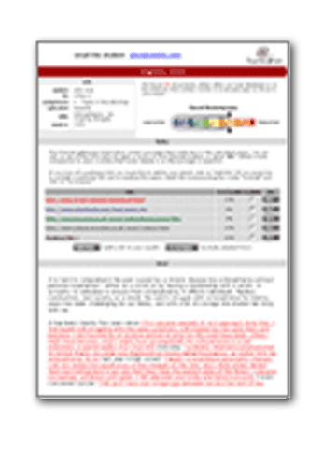
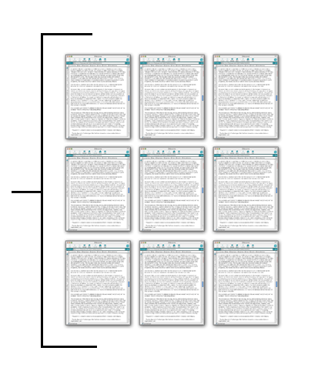
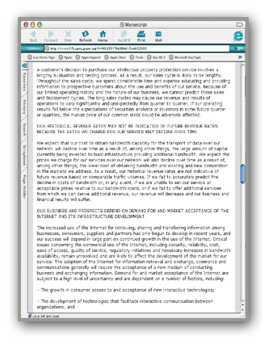
ORIGINALITY REPORT
Matching passages from 12+ billion Internet web pages: updated at a rate of million pages/day
Create Originality Report
Matching passages from millions of Books, Journals, Newspapers
Compare matching passages to original manuscript or article
Matching passages from millions of Student Papers or Client Node
Notes:
4
4

Slide 5
WHAT DOES TURNITIN SEARCHES?
Current and archived copy of the publicly accessible Internet
(more than 12 billion pages indexed)
90 millions of student papers submitted to Turnitin since 1996
Millions of published works from ProQuest, Emerald, EbscoHost,
Gale Cengage, Thomson Reuters, Science Direct, ABC-CLIO,
The Gutenburg Collection and CrossRef (CrossCheck).

Slide 6
Getting Started…

Slide 7
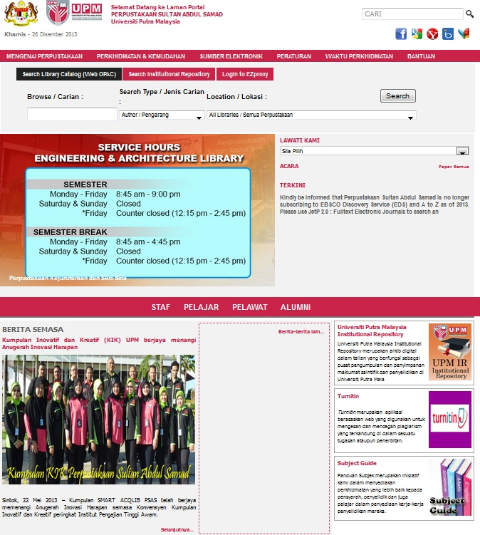
Visit the library website: http://www.lib.upm.edu.my
Click here

Slide 8
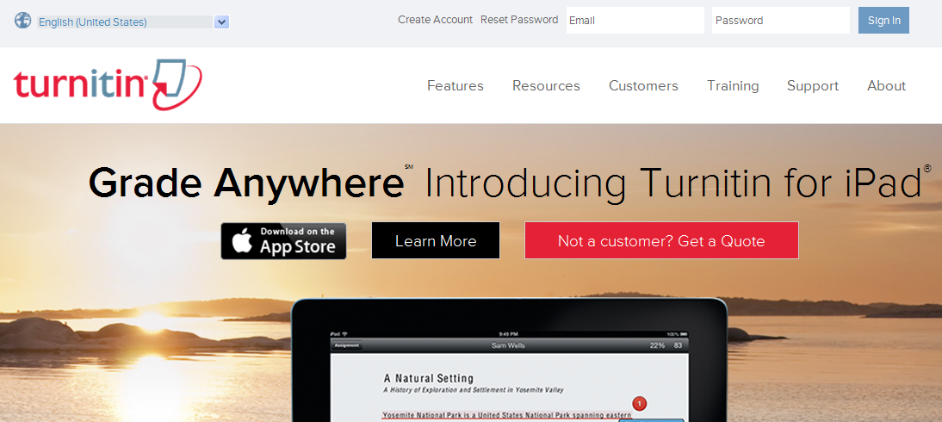
Register student account (once only)
1
1. Click on “Create account” link

Slide 9
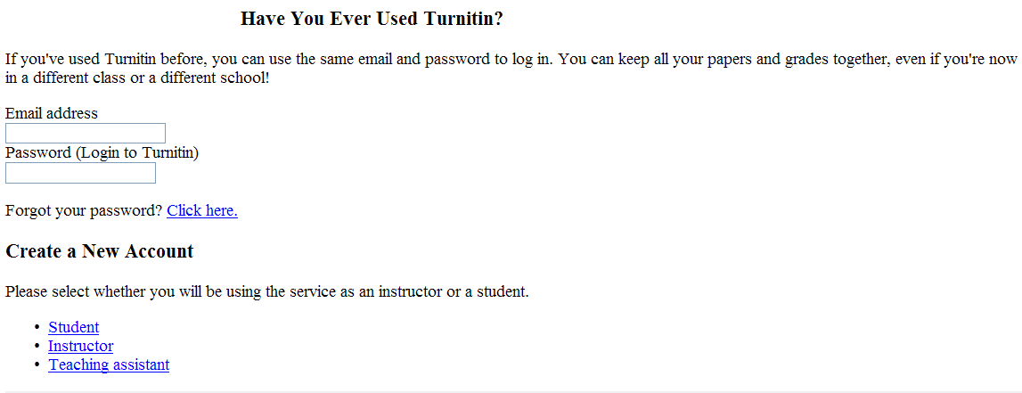
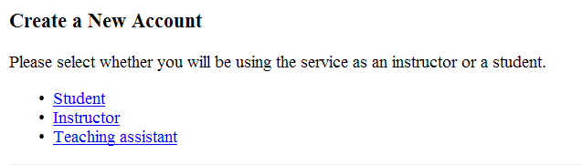
2. Go to
“Create a
New Account” and click
“Student”
2

Slide 10
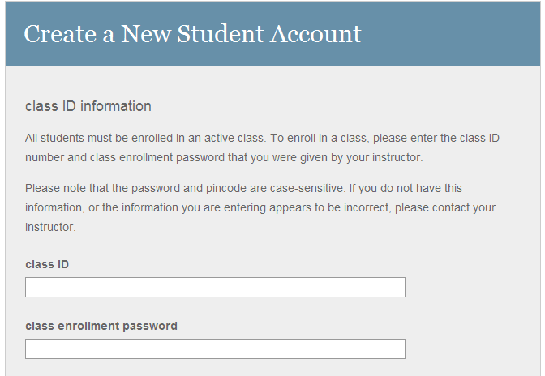
3. Fill up the Class ID
& Class enrollment password
**Please get from your lecturer/supervisor
3

Slide 11
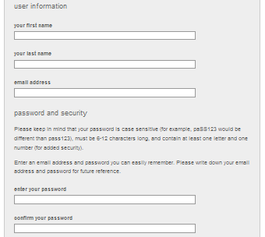
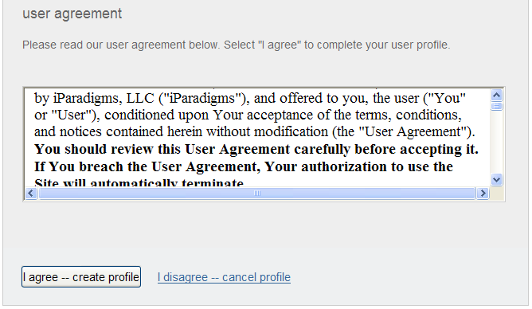
4. After filling up your profile, click on
“I agree…..create profile”
4

Slide 12
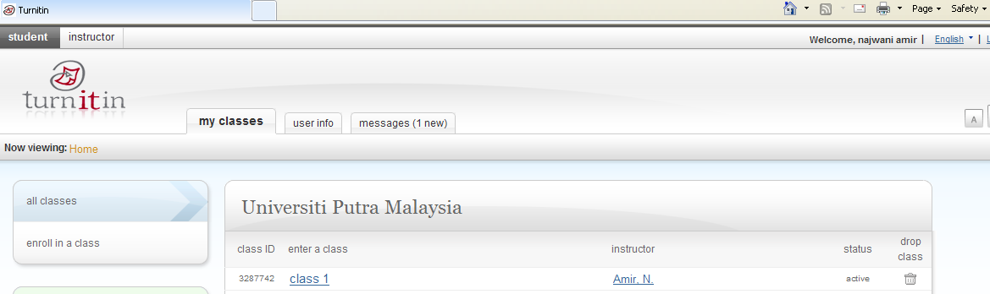
To submit your assignment
Your class will show up on your homepage.
5. Click “class name” e.g: Class 1”
5

Slide 13
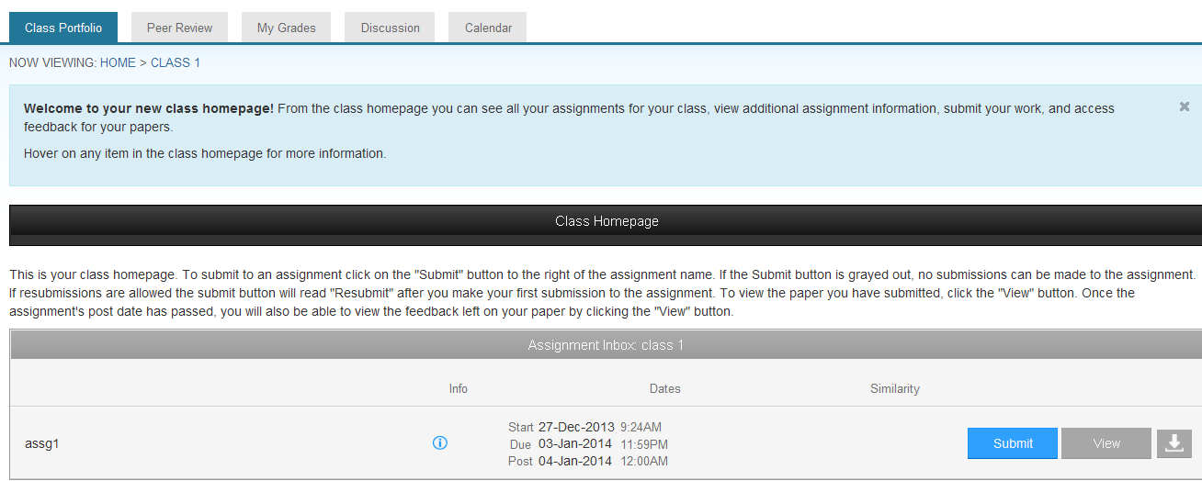
You will see the class name; e.g: Class 1 and assignment name; e.g: assg1 (Both of them have been created by your lecturer/supervisor)
6. Click “submit” to upload your paper
6

Slide 14
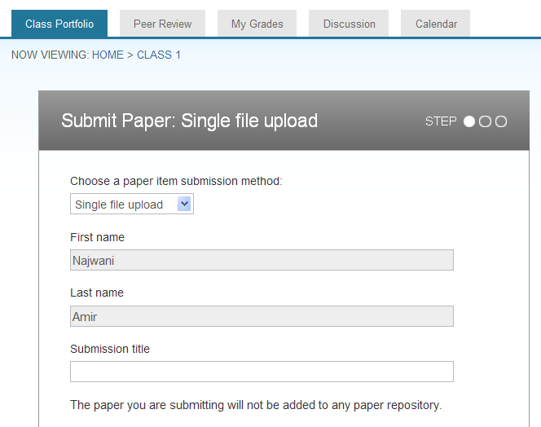
7. Select “single file upload” for choose a paper submission method.
8. Then, fill up your assignment title.
7
8

Slide 15
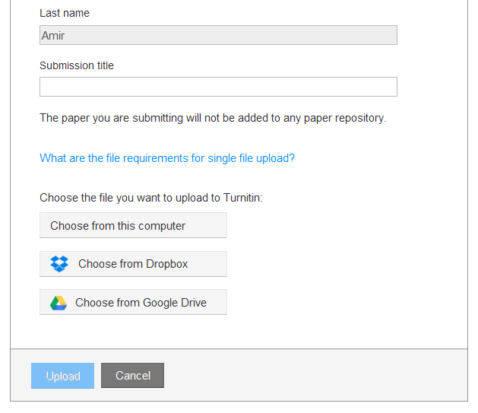
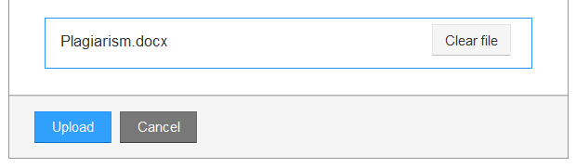
9. Choose the file you want to upload.
9
10. Then, click ‘’Upload”
10

Slide 16
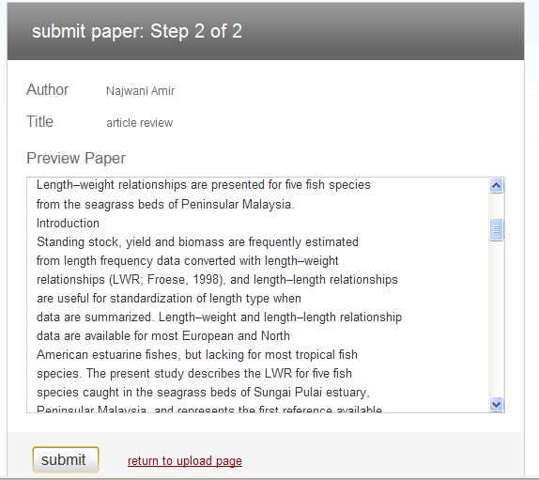
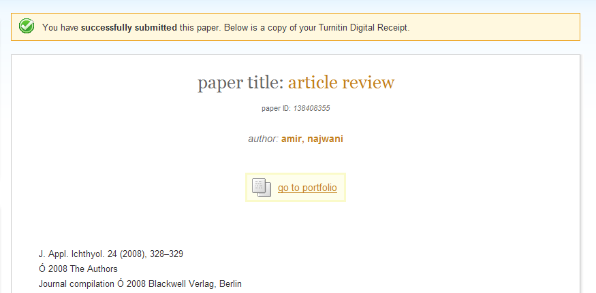
11. Click “submit” to submit your paper.
After your paper has been successfully submitted
12. Click “go to portfolio” to view the brief
Originality
Report
11
12

Slide 17
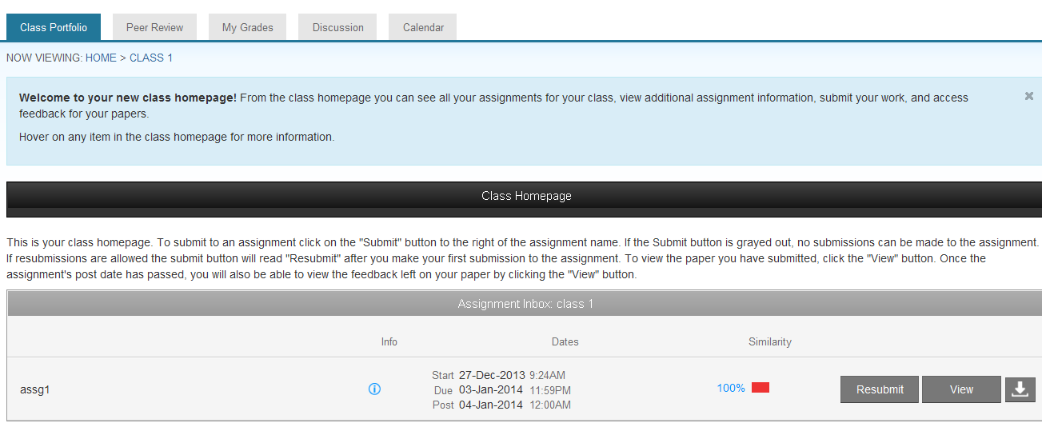
To view your report
13. Click the “% of similarity” e.g. 25% to view the Originality Report .
You may have to wait a while for the report to be prepared, depending on the size of the file. Keep on refreshing the page till you get the report or check it again on the following day.
13

Slide 18
14. If you wish to
resubmit your
paper, click on the
“Resubmit” icon on
the same page
where you click to
view the Originality
Report. It will
overwrite your
initial submission.
14

Slide 19
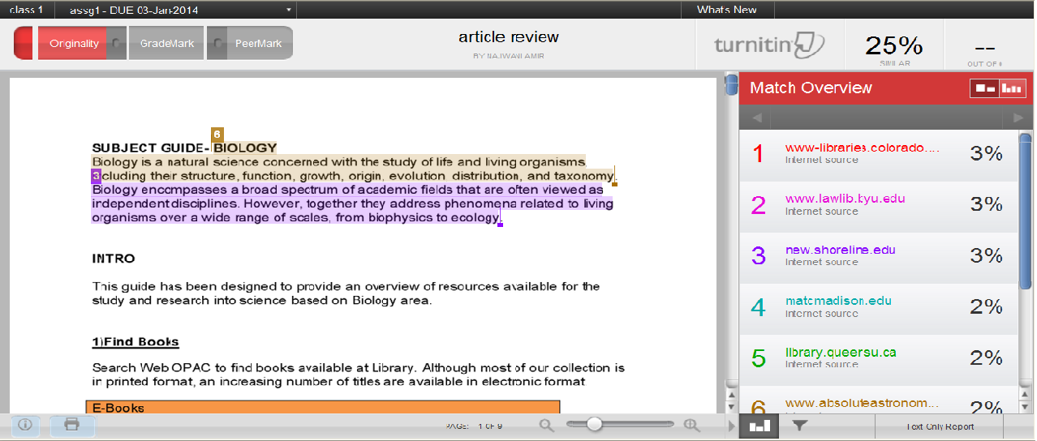
The detail of similarity report
Your thesis/assignment
Total % of similarity report
Match overview to the sources

Slide 20

Download & Print the report
15. To print
/download a
report, click on
the “print” icon at
the bottom of the
Originality Report
and select
“download PDF of
current view for
printing”.
Download & Print the report
15

