Slide 1
How To Access
PERPUSTAKAAN SULTAN ABDUL SAMAD
“Gateway to Knowledge Across the World”
Online Journal via Ezaccess

Slide 2
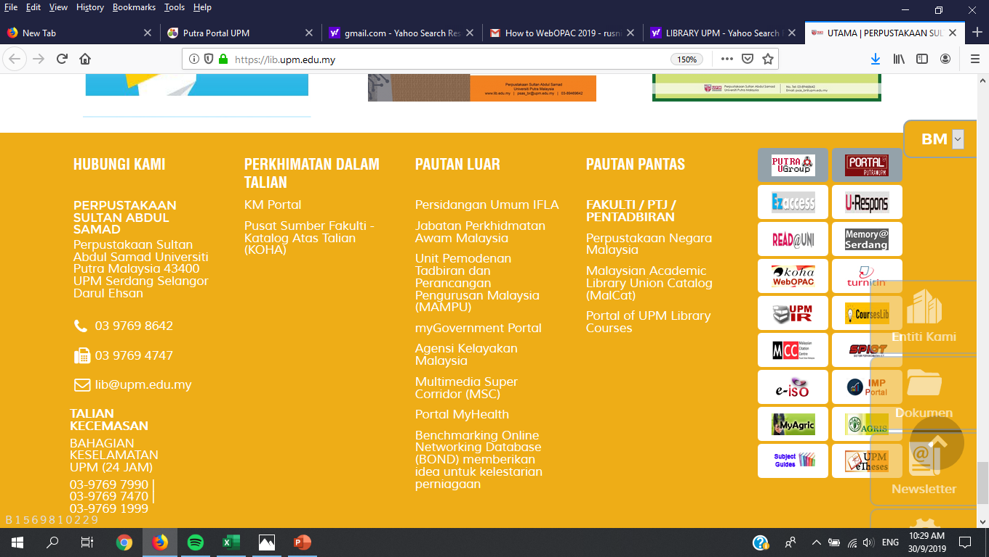
SEARCHING FOR ONLINE JOURNAL
1. Access Library Website : https://lib.upm.edu.my
2. Click “Ezaccess” icon

Slide 3
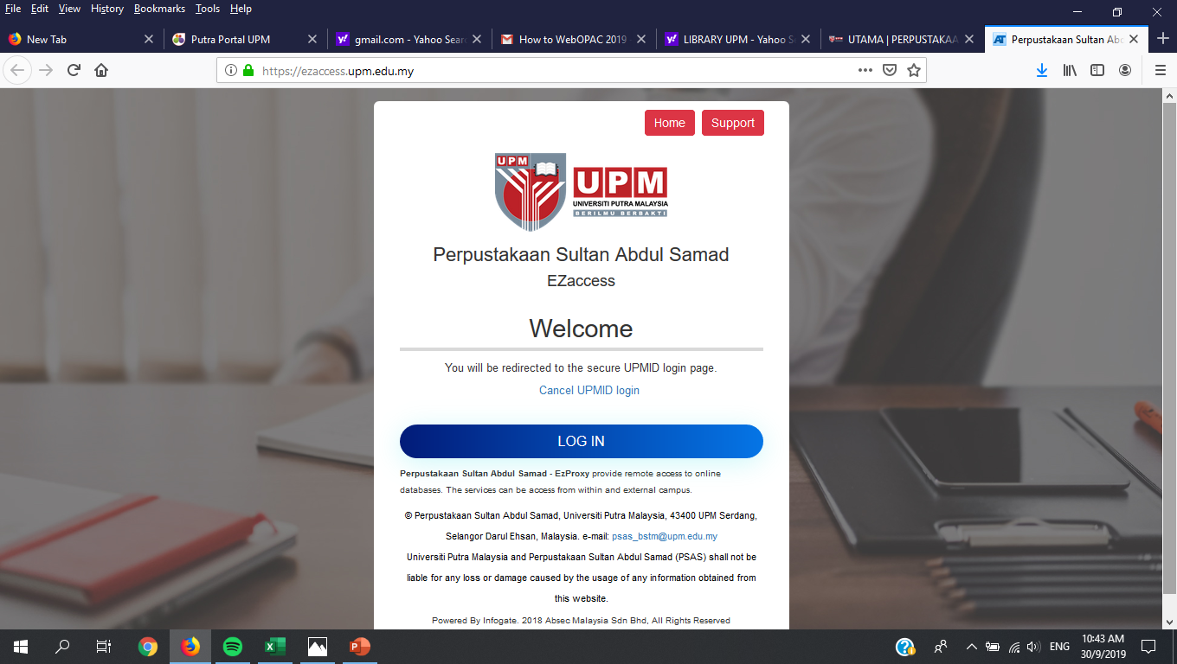
SEARCHING FOR ONLINE JOURNAL
3. Click “L OG IN” Button

Slide 4
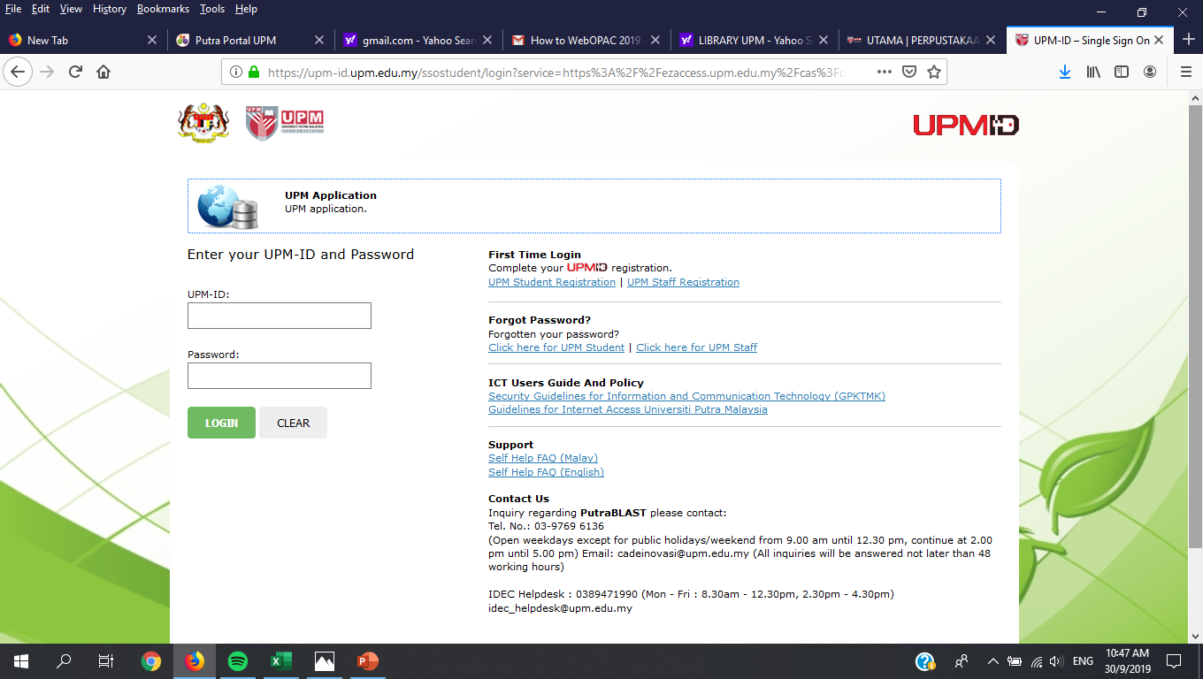
SEARCHING FOR ONLINE JOURNAL
4. Key in Your UPM-ID and Password

Slide 5
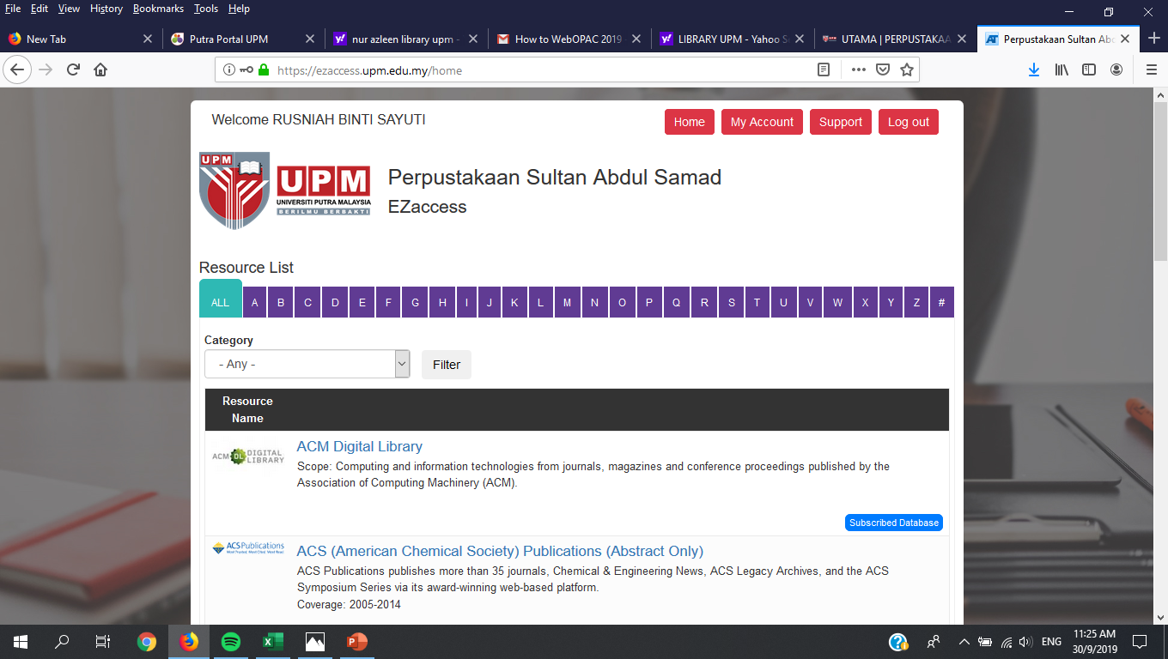
SEARCHING FOR ONLINE JOURNAL
5. You can choose any related subscribed online databases by browsing the listing of subscribed online database or if you already have selected online database, you can click on the alphabet, for example “S” for ScienceDirect

Slide 6
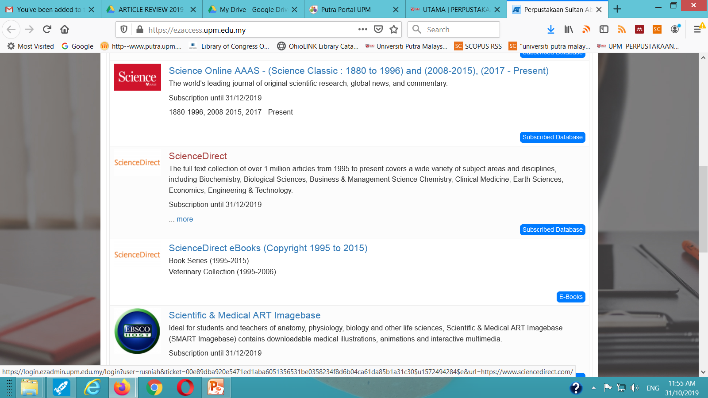
SEARCHING FOR ONLINE JOURNAL
6. Click ScienceDirect link

Slide 7
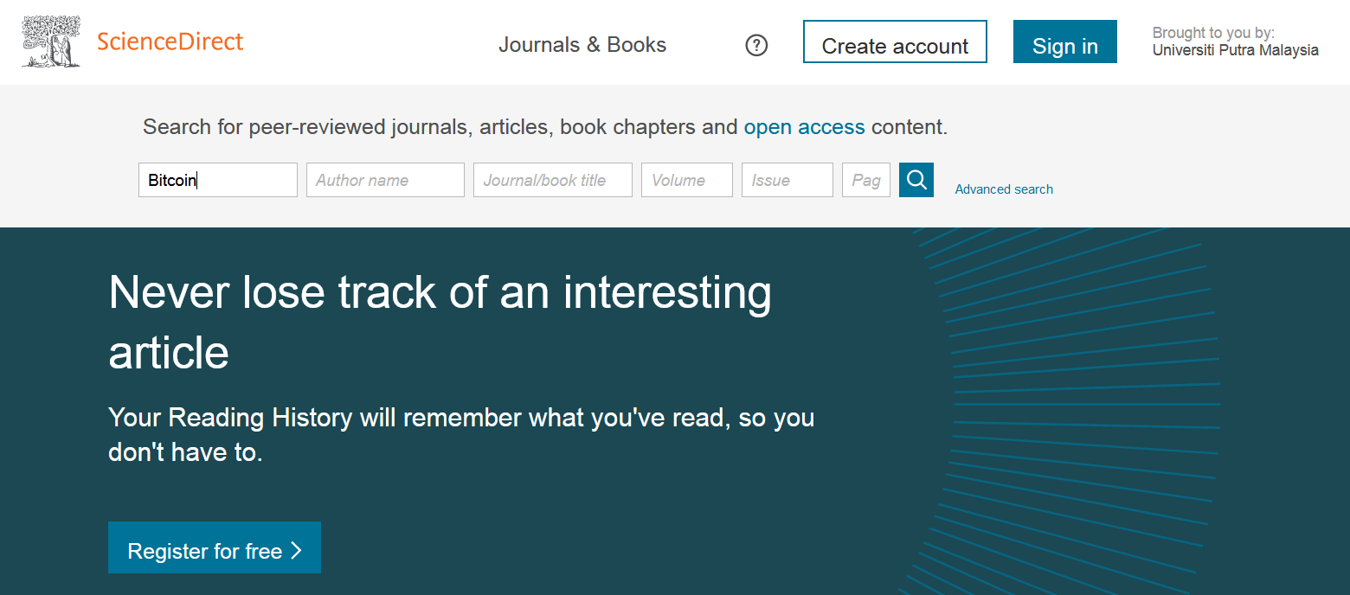
SEARCHING FOR ONLINE JOURNAL
8. Click search button
7. Type any desired keyword.

Slide 8
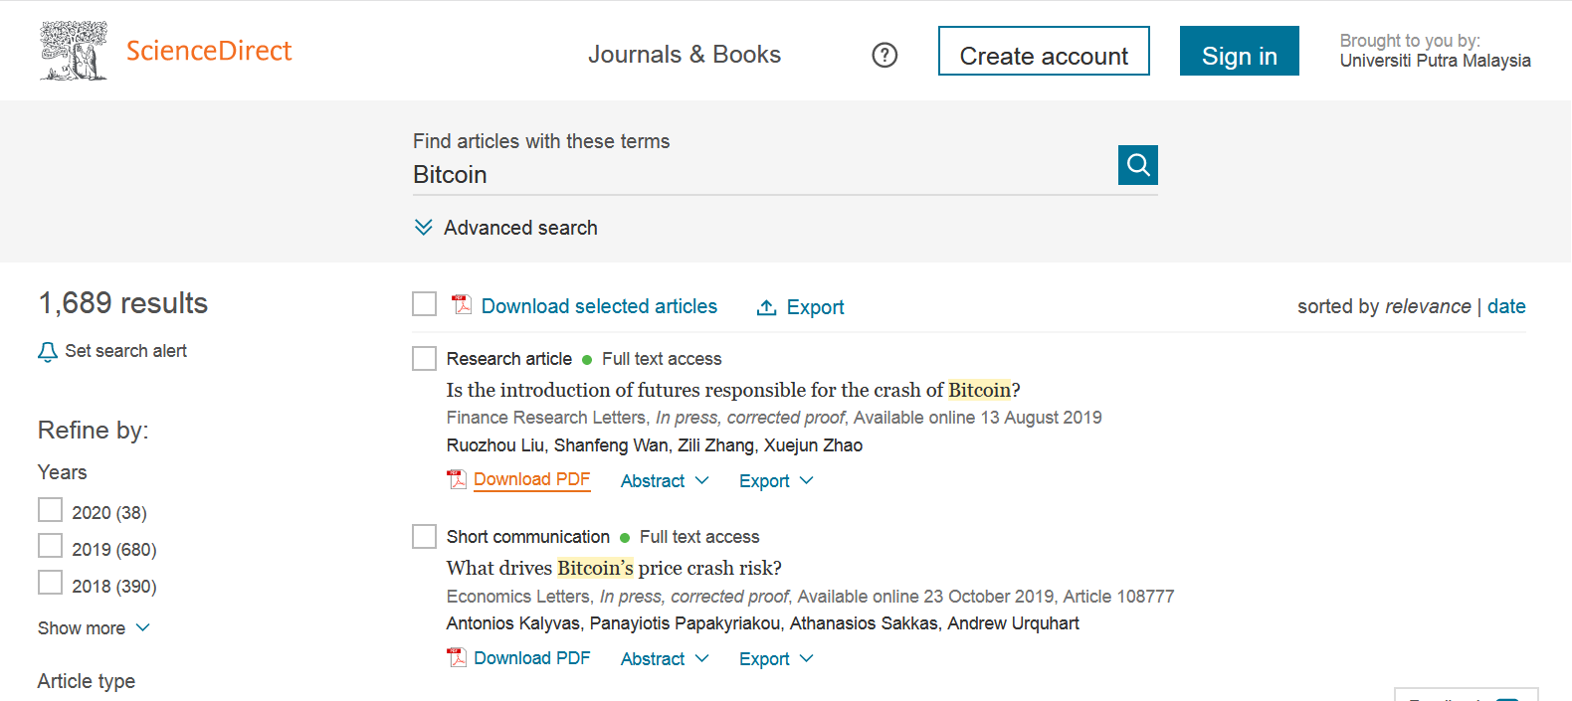
SEARCHING FOR ONLINE JOURNAL
9. Click Download PDF link to get full text article

Slide 9
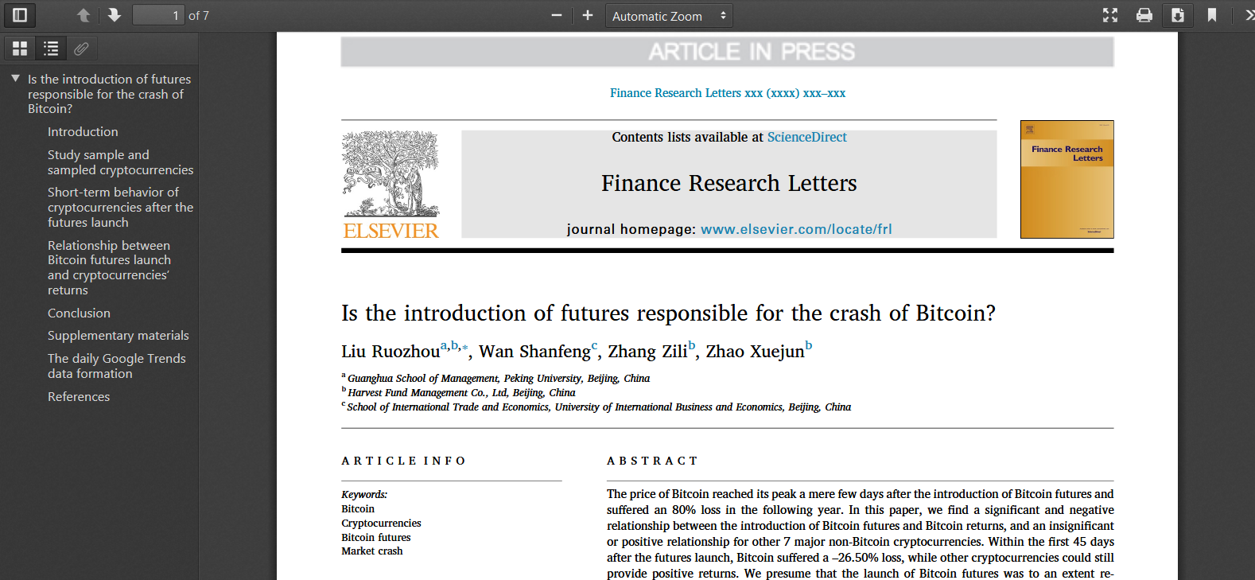
SEARCHING FOR ONLINE JOURNAL
10. Click download button to save the full text PDF article

