Slide 1
Student Quick Start Guide
Prepared by:
Information Services Division
Perpustakaan Sultan Abdul Samad
Universiti Putra Malaysia
2015

Slide 2
Outlines
What Is Turnitin?
Accessing Turnitin
Step 1 : Creating a User Profile
Step 2 : Student Homepage
Step 3 : Class Portfolio
Step 4 : Submitting a Paper
Step 5 : Submitting a Paper Confirmation
Step 6 : Viewing an Originality Report
Step 7 : Viewing Instructor Feedback in GradeMark

Slide 3
What Is Turnitin?
INTRODUCTION
Turnitin is the leading originality checking and plagiarism prevention service used by millions of students and faculty, and thousands of institutions worldwide.
Turnitin encourages best practices for using and citing other people’s written material.
The service offers a complete web-based service to manage the process of submitting and tracking papers electronically, providing better and faster feedback to students.

Slide 4
Accessing Turnitin
To access Turnitin, each user must create a unique user profile. The user profile consists of an e-mail address, user password, optional personal information, and a set of user preferences.
There are two ways for a student to obtain a Turnitin user profile.
Email from Turnitin (An instructor may add the student to the course, in which case the student would receive an e-mail with a temporary password and login instructions)
Class ID and Enrollement Password

Slide 5
Getting Started…

Slide 6
Where to find Turnitin?
Visit the library website at http://www.lib.upm.edu.my/
Click here to begin

Slide 7
Where to find Turnitin?
Click on Turnitin. You will be directly linked to the Turnitin homepage.
Click user’s guide for more detail.
Link to Turnitin homepage
User’s Guide

Slide 8
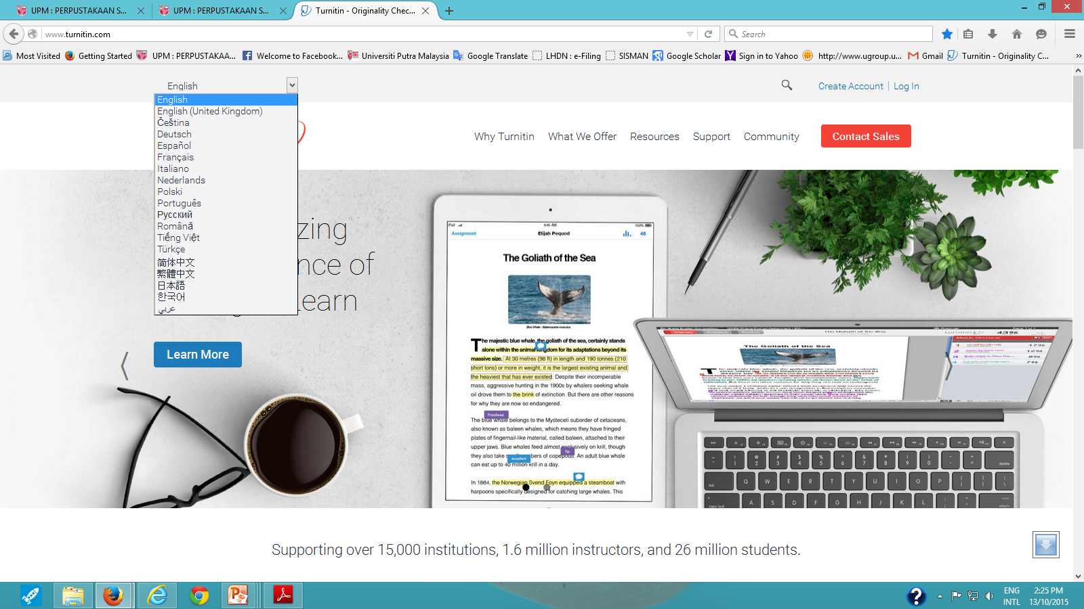
STEP 1 : Creating a User Profile
Turnitin home page : http://www.turnitin.com/
Click on the "Create Account” link next to the Log In button.
You will be directly linked to the “Create User Profile“ page.
Note
You can select your language from the drop down menu.
1
Language drop down menu

Slide 9
STEP 1 : Creating a User Profile
Click on the "Student" link.
2

Slide 10
STEP 1 : Creating a User Profile
Enter the class ID number and the class enrollment password.
You can get this information from your instructor.
Enter the user first name, last name, and a valid e-mail address to use as the login for Turnitin.
Create a user password. The user password must be between six and twelve characters long and contain at least one letter and one number. Re-enter the password to confirm it
Select a secret question from the dropdown menu. Enter the answer for the question. Remember and keep this information. The answer is case and space sensitive
5
3
6
4

Slide 11
STEP 1 : Creating a User Profile
Review the user agreement. To continue using Turnitin, click on “I Agree – Create Profile”.
From the completed user profile creation page, click on “Log in to Turnitin”.
7
8

Slide 12
STEP 2 : Student Homepage
Your class will be displayed on your Student Homepage. Click on the name of your class to open your class portfolio. (e.g. Thesis).
9

Slide 13
STEP 3 : Class Portfolio
Your Class Portfolio shows the assignments your instructor has created and your submissions to the class.

Slide 14
STEP 4 : Submitting a Paper
To submit a paper, click on the "Submit" button next to the paper assignment. The paper submission page will be displayed.
10

Slide 15
STEP 4 : Submitting a Paper
Turnitin accepts submissions in these formats:
Microsoft Word™ (DOC and DOCX)
Corel WordPerfect®
HTML
Adobe PostScript®
Plain text (TXT)
Rich Text Format (RTF)
Portable Document Format (PDF)
Microsoft PowerPoint (PPT, PPTX, and PPS)
Hangul (HWP)
If your paper is in a format that turnitin do not accept, you can submit it by “Cut & Paste”.

Slide 16
STEP 4 : Submitting a Paper
Select “single file upload” from the Submit: pull down menu.
Enter a title for the submission. (e.g. Subject Guide).
Once the requirements for single file upload have been reviewed, students have a choice to upload a file from the Computer, Dropbox or Google Drive. Click one of the submission buttons and then select the file you would like to upload.
Click on "Upload" to upload the file.
11
12
13
14

Slide 17
STEP 5 : Submitting a Paper Confirmation
The paper you chose to submit will be in the preview. Look over all the information and make sure that it is correct.
Click the “Confirm” button to upload the file to the assignment.
Preview
15

Slide 18
STEP 5 : Submitting a Paper Confirmation
After you have confirmed your submission, a digital receipt will be shown. A copy of the receipt will be e-mailed to you.
To return to your portfolio and view your submission, click the "Return to assignment list" button.
12

Slide 19
STEP 6 : Viewing an Originality Report
To view your Originality Report, click at the percentage (%) on the “Similarity” column or “View” button to the right of the assignment.
Note :
The Originality Report provides a summary of matching or similar areas of text found in a submitted paper. The originality Report shows a percentage and a corresponding colour indicating on a index where this percentage falls in term of matching content.
13

Slide 20
Note : If originality reports are Not Available
If “Not Available” appears under the Similarity column for the assignment, then Originality Reports are not available to student in this assignment.
Students wishing to view or receive a copy of the Originality Report for their submissions must contact the instructor. The determination of authorizing access to this information is in the hands of the instructor and institution.

Slide 21
Note: Downloading Submitted Paper & Resubmitting
Downloading Submitted Papers & Digital Receipts
Previously submitted papers can be downloaded by the user. The downloadable version of the file is in the original format of the submission, indicated by the file type name to the right of the file download icon.
Students may download the digital receipt for submissions at any time from the student’s class home page.
Some assignments may allow students the ability to overwrite their previous submissions until the due date and time set for the assignment. This option can be set by the instructor on an assignment by assignment basis. If overwriting is not enabled, the instructor must manually delete a previous submission to allow the student user to submit a second file.
Resubmitting

Slide 22
Originality Report Content
Document viewer frame
The Originality Report is separated into three main areas:
Document viewer frame - shows the Similarity Index for the report and the title and author of the paper.
Paper text - the submitted paper text in its original formatting. Matching text is highlighted in a colour that corresponds to the matching source listed on the right side of the Originality Report.
Matching sources/sidebar - the list of matching sources for the highlighted areas of the paper text to the left. The sidebar also displays the Filter and Settings (exclusion options)
Paper text
Matching sources/sidebar

Slide 23
Paper Information
The paper information can be viewed by clicking on the information icon at the bottom left of the document viewer.
The paper information contains: the submission id, the date the paper was processed, the word count, the character count, the number of submissions to the assignment, the overall similarity index, and the three repository indices.
Paper information
14

Slide 24
Downloading Reports & Digital Receipts
To print/download a report, click on the print icon at the bottom of the Originality Report. Select “Download PDF of current view for printing. .
Click to print/ download a report
15

Slide 25
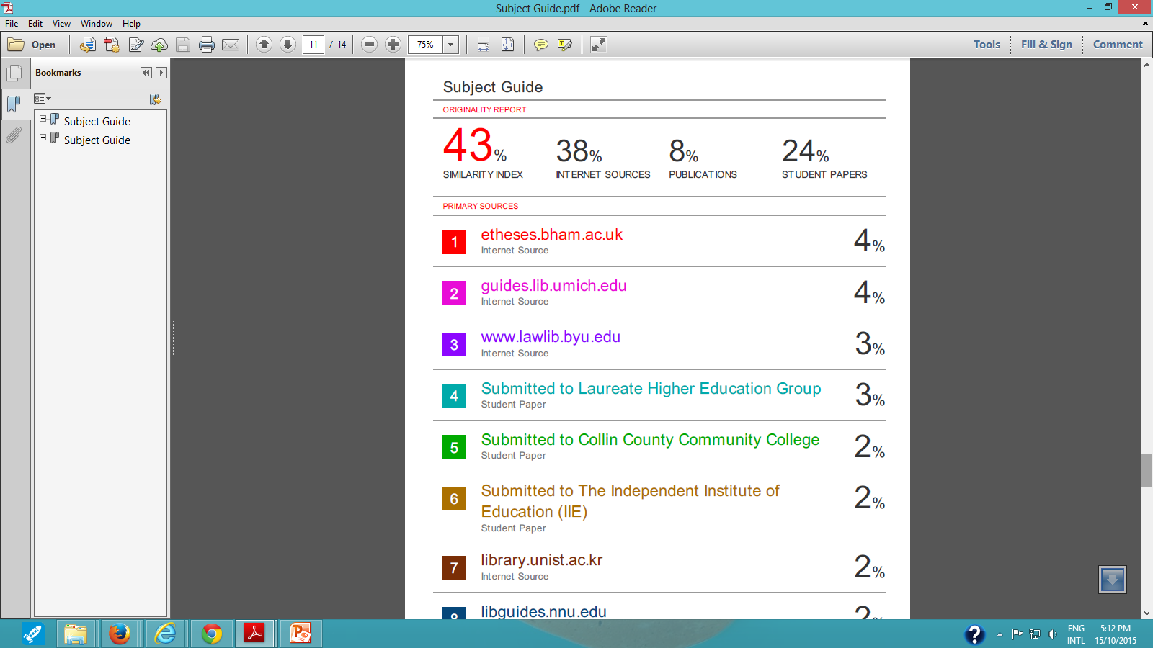
Downloading Reports & Digital Receipts
The full report will be displayed in PDF format. You can save/ print.

Slide 26
STEP 7 : Viewing Instructor Feedback in GradeMark
To view a marked paper, click on the blue View button next to the assignment.
The student GradeMark paper view will be opened in a separate window in which the student may view or print the grade and comment information
Note:
If the GradeMark View button is gray, the post date of the assignment has not been reached or the instructor has not yet graded or marked the paper. Contact the instructor for further information.
16
The student Grade Mark
View button - gray

