Slide 1
KEYWORD SEARCH
Keyword search allow searches using combination of keywords and the use of Booleans (and, or, not). Options in keywords/phrases searches are:
Author
Subject
ISBN, ISSN, LCCN
Title
Anywhere (Referring to all search fields)

Slide 2
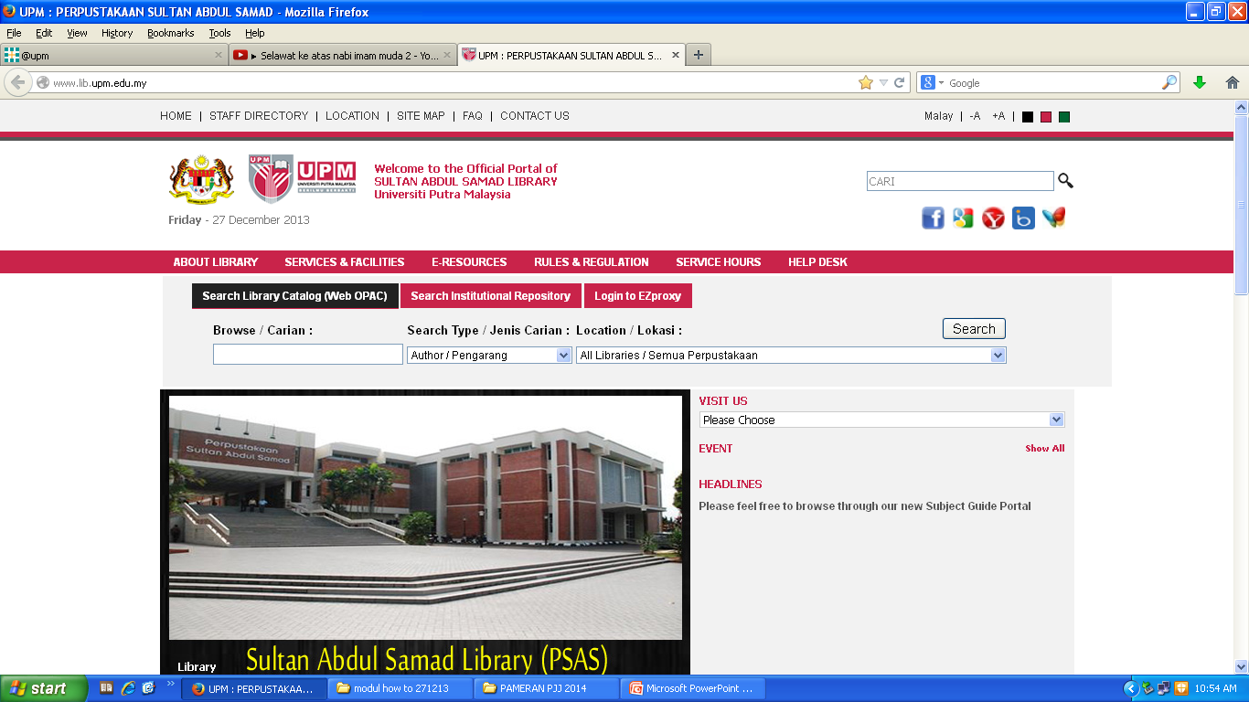
HOW TO FIND BOOK VIA WEBOPAC KEYWOOD SEARCH
Click here to begin

Slide 3
KEYWORD SEARCH
Click ‘Keyword
(Advance Search)’

Slide 4
KEYWORD SEARCH USING “AND”
1
3
Type the term(s) to be searched in each text box labeled Words
e.g (psychology, Kalat, James W.).
2. Select one or more logical connectors, or operators, to combine your keywords e.g. AND
3. Select Search Type
e.g. Title & Author
Select the Location
e.g. All Libraries
5. Click the Search button.
5
2
4

Slide 5
KEYWORD SEARCH USING “AND”
Search Results

Slide 6
KEYWORD SEARCH USING “OR”
1
3
5
Type the term(s) to be searched in each text box labeled Words
e.g. psychology, attitude
2. Select one or more logical connectors, or operators, to combine your keywords e.g. OR
3. Select Search Type
e.g. Title
Select the Location e.g. All Libraries
5. Click the Search button.
2
4

Slide 7
KEYWORD SEARCH USING “OR”
Search Results

Slide 8
KEYWORD SEARCH USING “NOT”
1
3
Type the term(s) to be searched in each text box labeled Word
e.g. psychology, attitude).
2. Select one or more logical connectors, or operators, to combine your keywords e.g. NOT
3. Select Search Type
e.g. Title
Select the Location
e.g. All Libraries
5. Click the Search button.
5
2
4

Slide 9
KEYWORD SEARCH USING “NOT”
Search Results
Click on ‘Items’ for information details

Slide 10
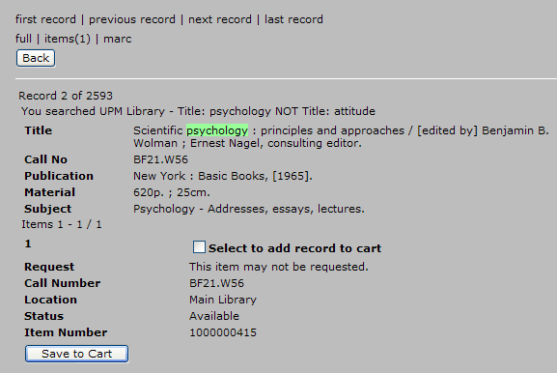
INFORMATION DETAILS OF THE BOOK
Call number: to locate the
material on the shelf
Location: to determine in which collection the material is shelved
Status: to indicate either the material is available or on loan or other status

