Slide 1
HOW HOW TO FIND E-JOURNALS
Online databases are accessible by registered UPM users by log in to ‘EZproxy'
Library website
Log in
Ez-Proxy
Online Databases
Read/evaluate and Use
Let’s try the following assignment / research topic as an example:
The effects of nutrition package claims, nutrition facts panels, and motivation to process nutrition information on consumer product evaluations
Keywords : nutrition facts, consumer

Slide 2
Log in through EZ-Proxy
Type in your Matric No. /Staff No.
e.g. ‘GS32143’
2. Type in your IC No. /Passport No.
e.g. ‘M0992137’
Click Login
3
1
2

Slide 3
This is the list of databases subscribed by UPM, arranged alphabetically.
Let’s try a search in Science Direct. To begin, click on “S”.
*Search the database which is relevant to your topic/subject
Click on “S”

Slide 4
Click on Science Direct e-Journals.
You will directly be linked to the database.
Click here
e.g. ScienceDirect e-Journals

Slide 5
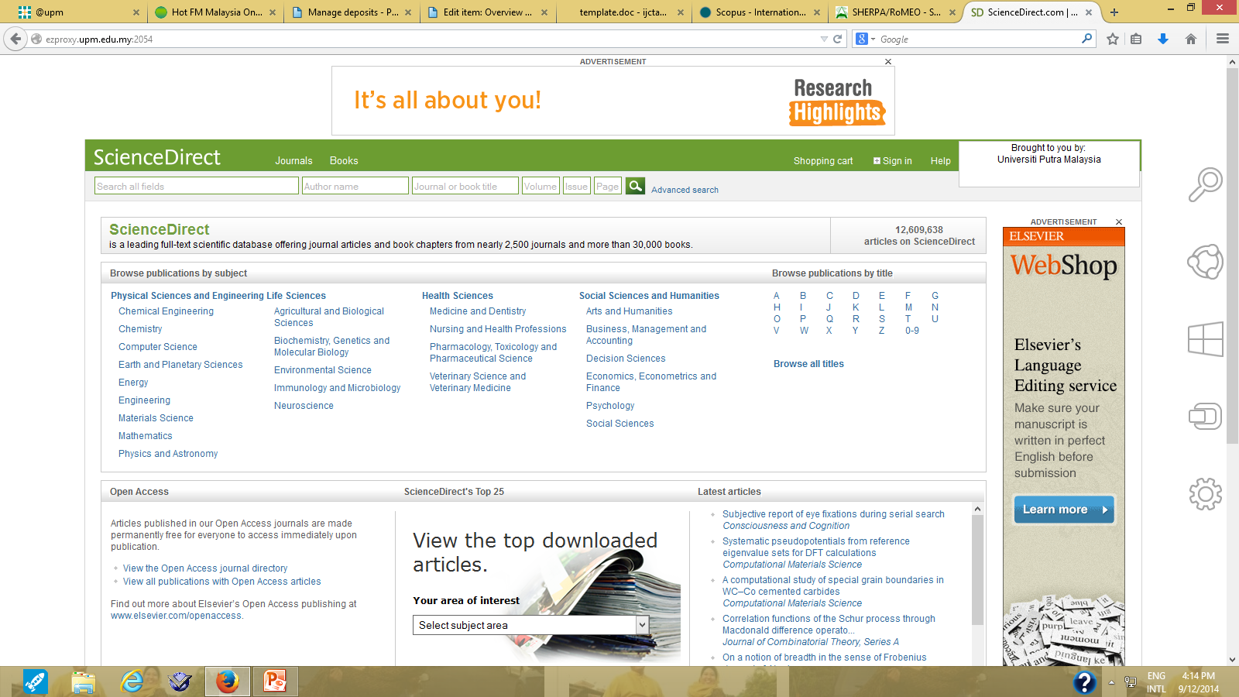
The front page of Science Direct will be displayed.
To begin your search, click on Advanced Search
Click here to begin

Slide 6
Advanced Search will allow you to combine keywords.
Select ‘Journals’ as the information sources
1
Type in your first keyword
e.g. nutrition fact
2. Choose appropriate boolean operator
e.g. AND
Type in your second keyword
e.g. consumer
4. Click on Search.
2
3
4

Slide 7
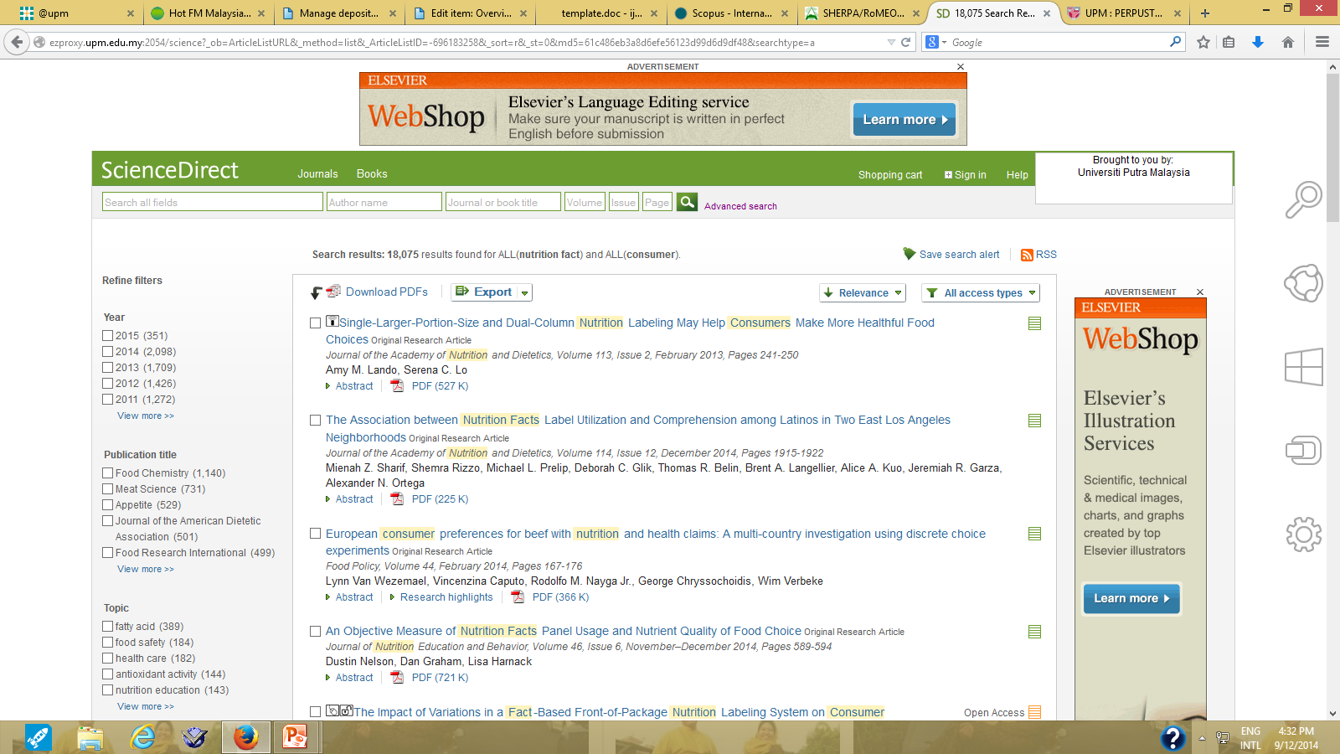
The results page will be displayed
Click here to
view the abstract
Click here to download ‘FULL TEXT’ article

Slide 8
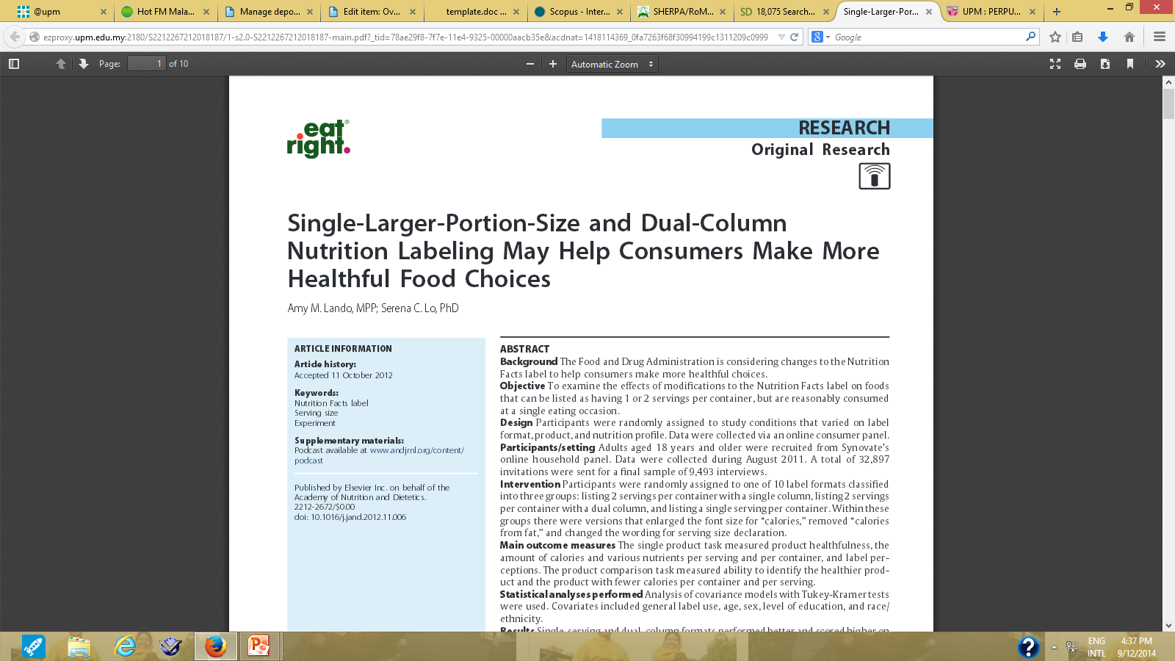
You can save, print, read and evaluate the article for your research or assignment.

